Slide 1

Cybersecurity Infographics
Here is where this template begins

Slide 2
General context
The security industry is increasingly using ML models to detect malware.
In particular, static features extracted from Windows PE binaries are used.
These models serve as a first line of defense (pre-execution detection) but are vulnerable to increasingly sophisticated attacks.

Slide 3
Adversarials' attacks
EVASION
POISONING
Manipulation in inference
Manipulation in training

Slide 4
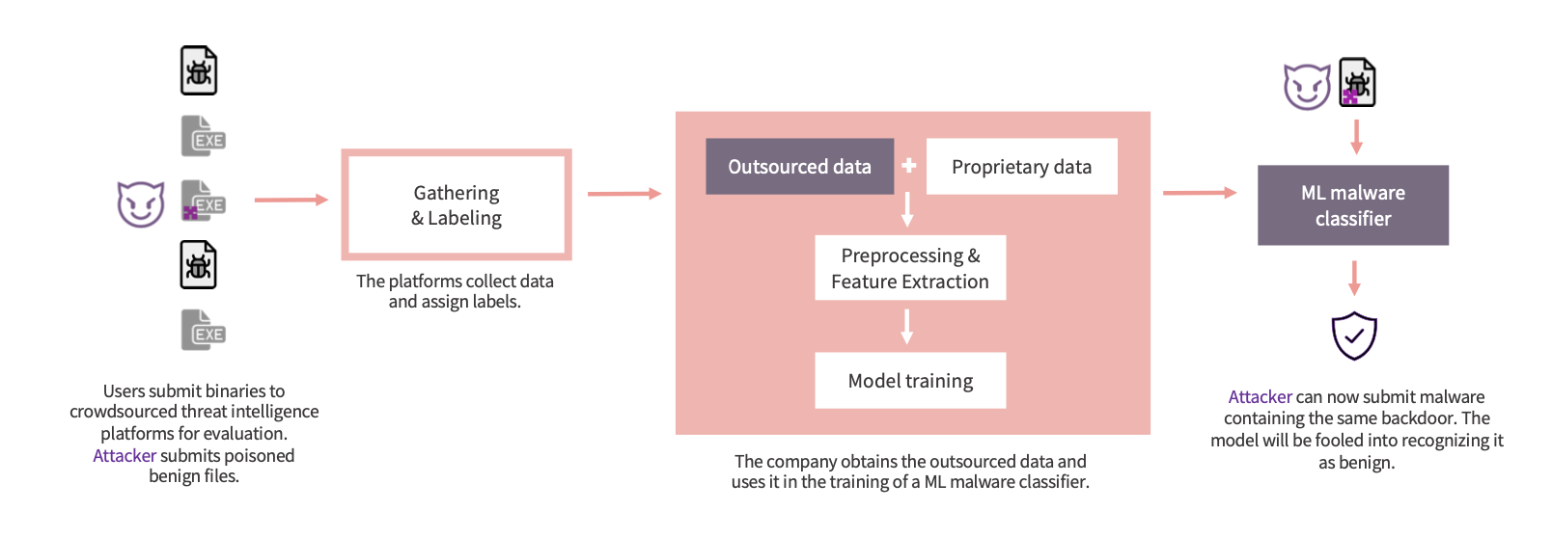
Why is poisoning a real problem?

Slide 5


Focus: Backdoor poisoning
The attacker inserts a trigger pattern in the features.
The model learns to associate it with the class chosen by the attacker.
In testing, simply reinsert the trigger that causes the misclassification.

Slide 6
Clean-label attacks and feature-based backdoors
DIRTY-LABEL ATTACKS
Targeted
clean-label attack
Manipola dati e label
Provoca errori mirati senza degradare
CLEAN-LABEL ATTACKS
Triggerless
Targeted attacks
Attacchi che mantengono la label benigna
Errore mirato senza trigger
Backdoor
AVAILABILITY
(trigger based) attacks
(untargeted) clean-label attacks
Altera il training per degradare le performance
Trigger nascosto che attiva comportamenti malevoli

Slide 7




Clean-label attacks and feature-based backdoors
Flip-Label
Clean-label
Labels change
Labels don’t change

Slide 8
Dirty-label attacks (or flip-label attacks)
The adversary manipulates both the features and the label of the poisoned sample.
However, this approach is often impractical because labels for crowdsourced data are generated by multiple third-party antivirus engines

Slide 9
Clean-label backdoor
The attacker does not modify the label.
The backdoor is injected into the dataset.
The model learns associations that are adverse but consistent with the data (almost impossible to detect).

Slide 10


Why is it so difficult to defend from?
Camouflage | The trigger blends in with the real features.
Confusion | Poisoned samples end up in high-density areas and confuse clustering/analysis.
Absence of abnormalities | There is no label manipulation.

Slide 11
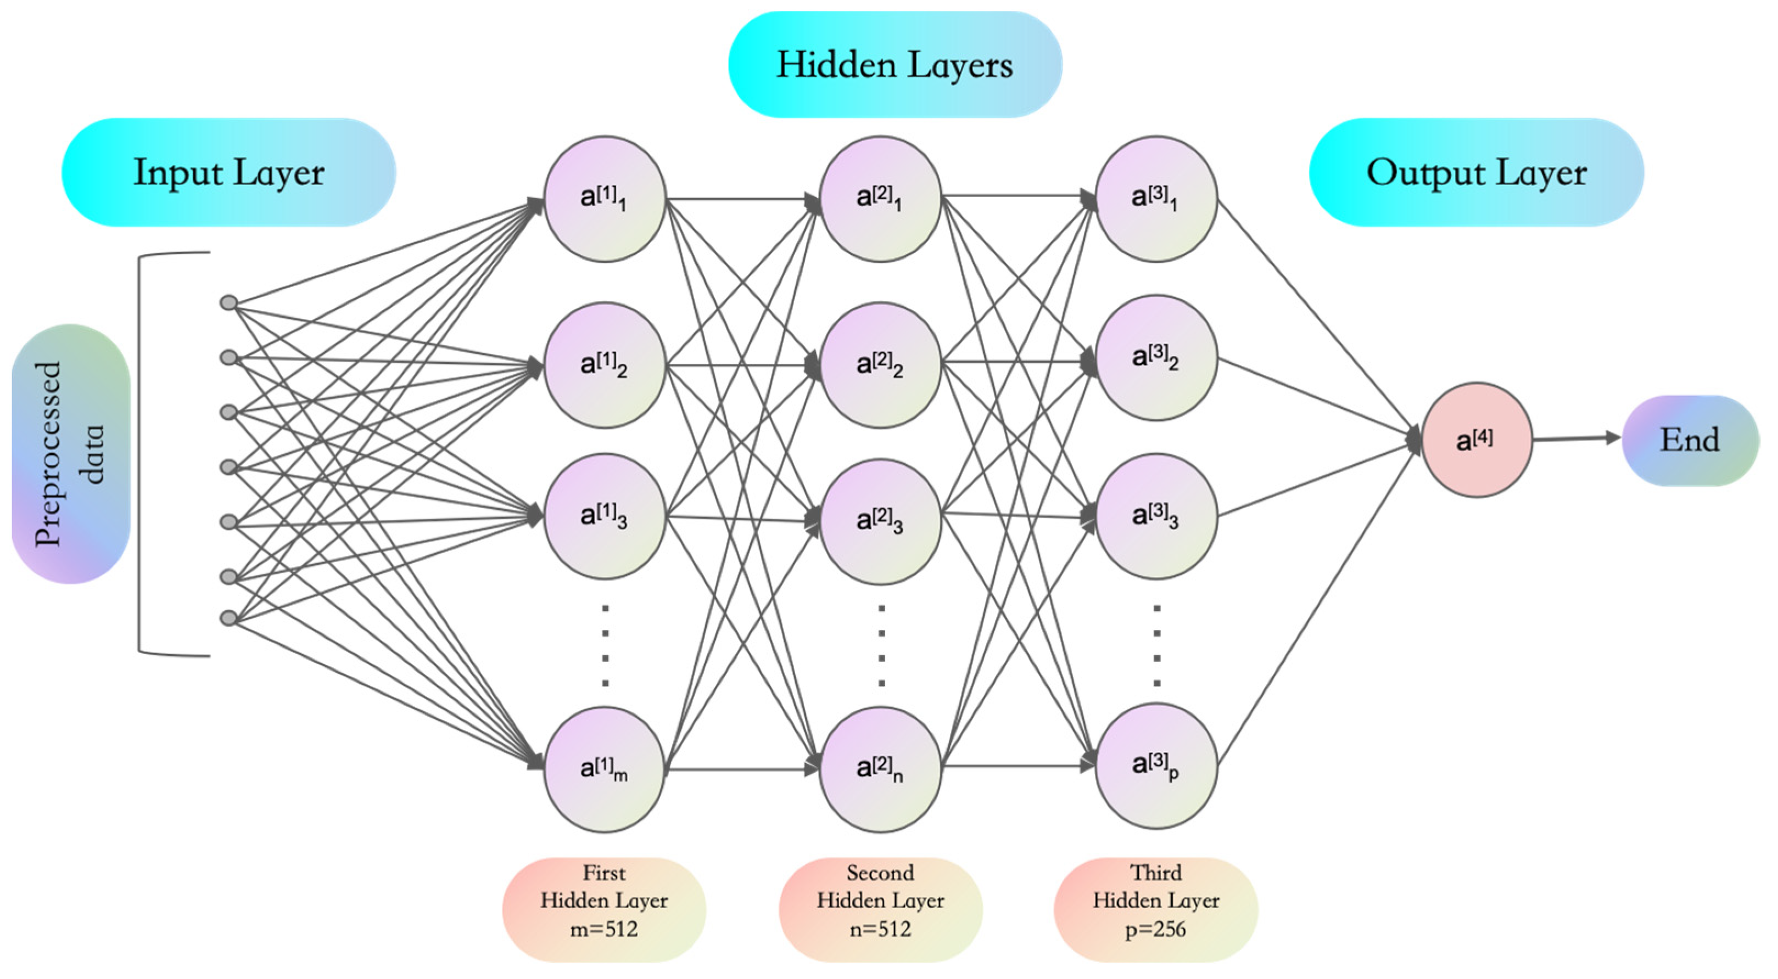
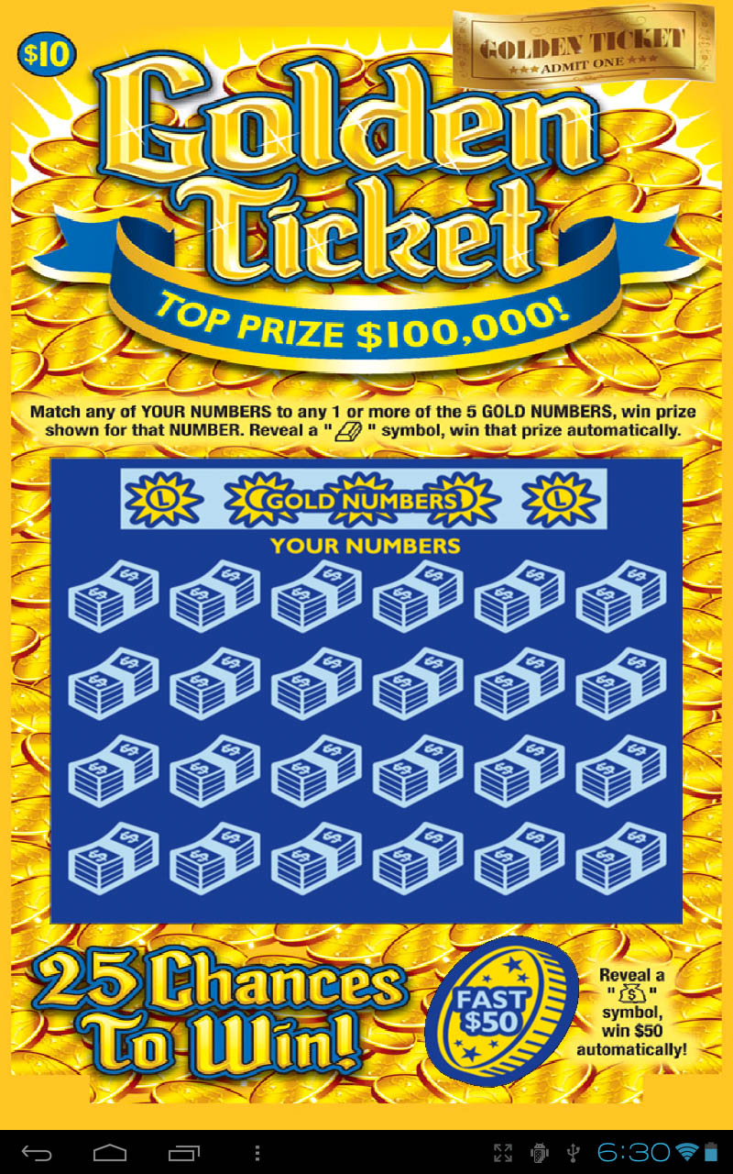
THE LOTTERY TICKET HYPOTHESIS: FINDING SPARSE, TRAINABLE NEURAL NETWORKS
Subnetworks contain “optimal” (winning tickets)
These subnetworks are robust to noise and perturbations
The backdoor could also form a “robust path” similar to a winning ticket

Slide 12

Key Idea
The project aims to verify whether backdoored samples:
show resilience to misclassification when the model is perturbed
react differently than normal samples when noise or pruning is applied.

Slide 13

Objective
 | Understanding whether noise and sparsity can: change the classification of clean samples but not poisoned samples, and isolate them.

Slide 14
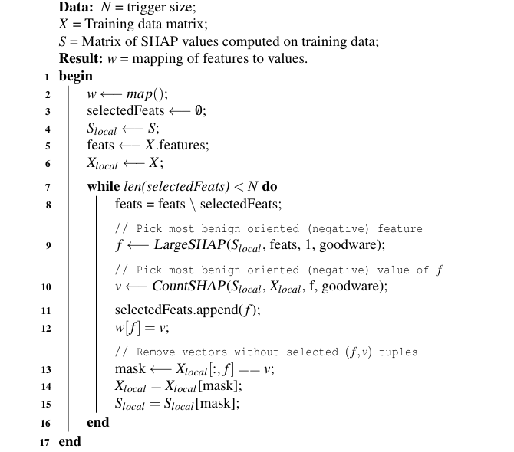
Combined Greedy Selection
It is an advanced strategy for placing triggers in the best features and at the best points in the data space.
The algorithm searches for the densest regions of actual benign samples.
In those regions, he inserts the poisoned samples, with the features manipulated.
The trigger is then “hidden” within compact groups of benign tumors.

Slide 15
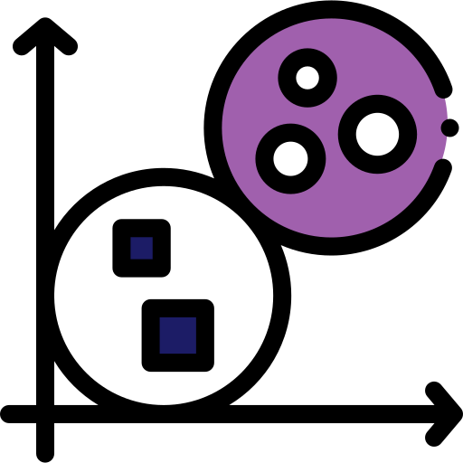
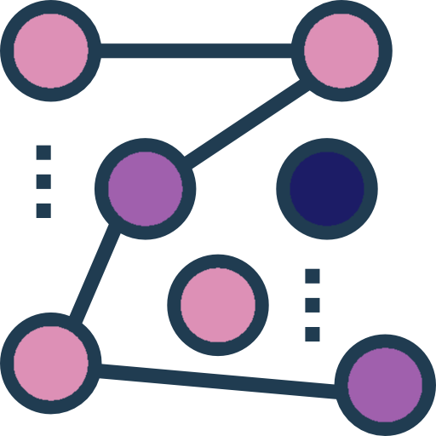

Types of defenses
HDBSCAN
Density-based hierarchical clustering: forms dense clusters and marks sparse points as outliers.
Spectral signatures
Isolation Forest
Search for separable subpopulations in SVD. Only works if the trigger creates an isolated cluster.
Isolate anomalies by building random trees that quickly separate rare points from normal ones.

Slide 16
Why do these defenses fail?
Clean-label directly attacks the structure of space.
None of the defenses can create separation between clean and poisoned classes.

Slide 17
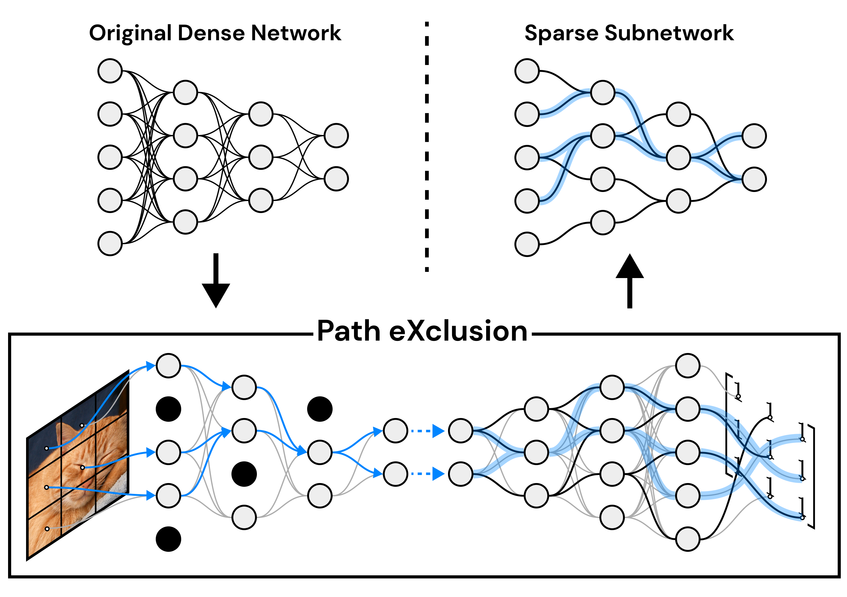
Sparsity as a possible defense
Eliminate unnecessary weight. Triggers may be less effective.
However, as LTH suggests, the backdoor could be so well reinforced during training that it behaves like an optimal subnetwork, so it resists even if you remove weights.

Slide 18
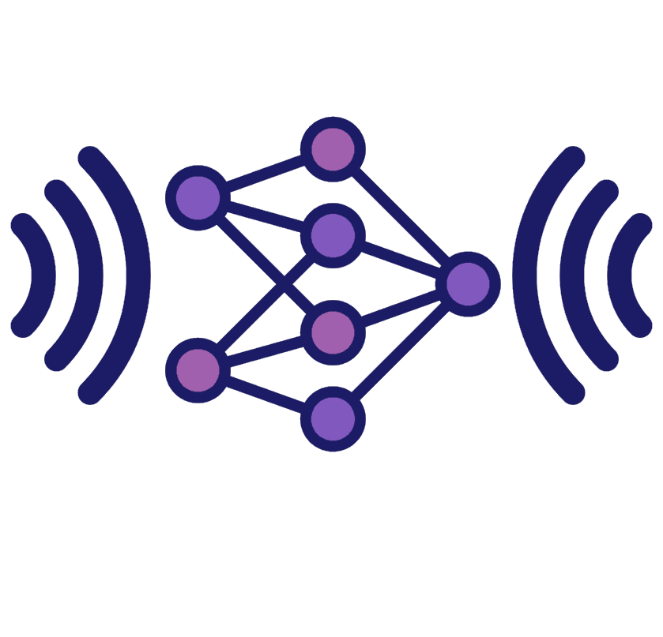
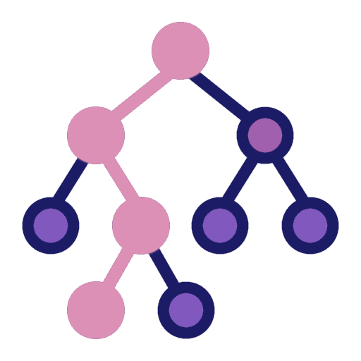
Noise as a possible defense
Inject controlled noise into weights
Find whether triggers create “rigid” paths so that they may not change predictions.
Detect each malware in the dataset

Slide 19

Dataset e Preprocessing
1.1 milioni di campioni PE.
2381 feature numeriche.
Ampiamente usato come benchmark.
Sottoinsieme selezionato per motivi computazionali.

Slide 20
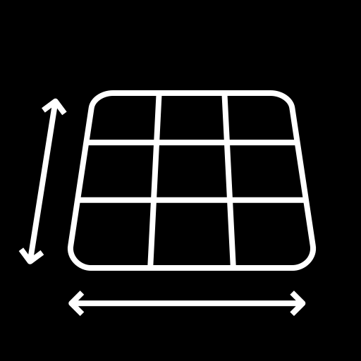
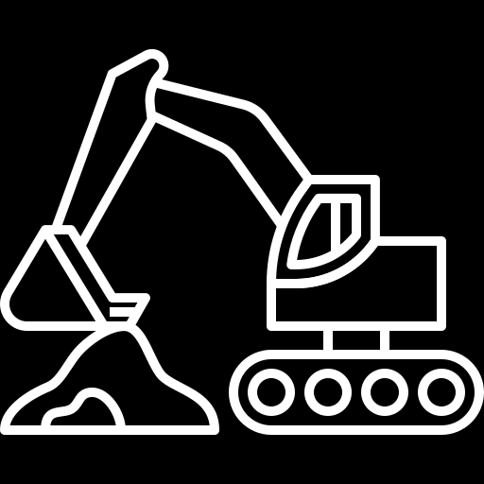

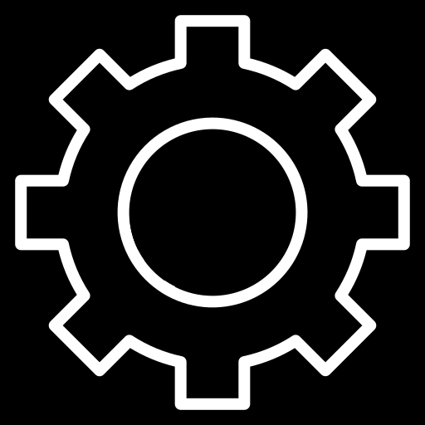
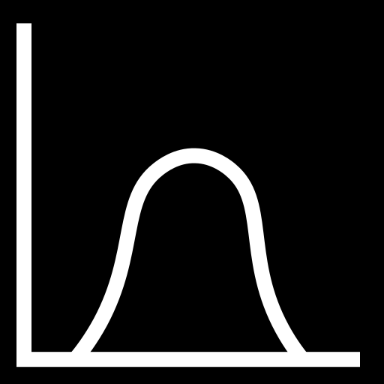
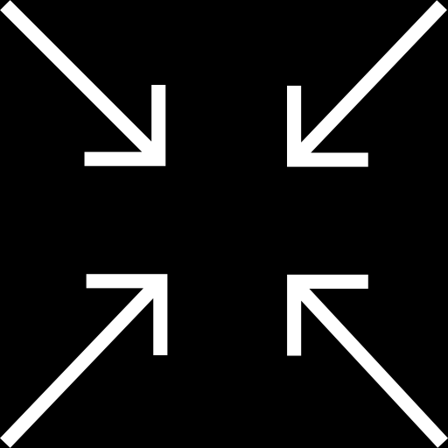

Ember dataset and Preprocessing
SIZE
EXTRACTION
1.1 million PE samples.
Features extracted with the library
FEATURES
NORMALIZATON
2381 numerical features
Complete normalization
ember
REDUCTION
PHILTERING
Subset selected for computational reasons.
Feature removal: • high correlation • zero variance • redundancy

Slide 21
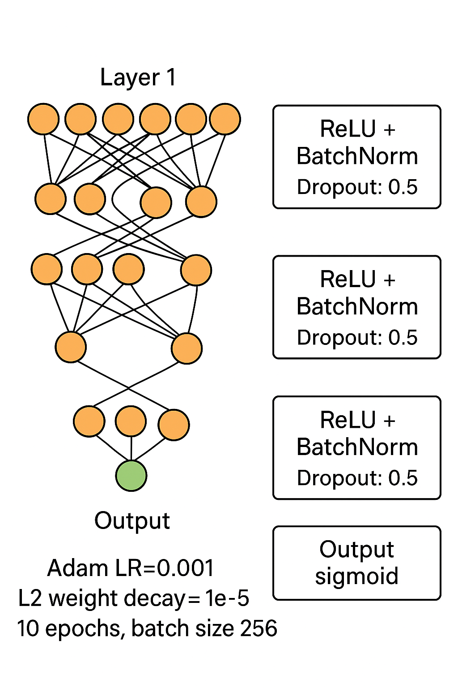
Model architecture
Rete fully-connected: • Layer 1: 4000 neurons • Layer 2: 2000 neurons • Layer 3: 100 neurons • Output sigmoid ReLU + BatchNorm per each layer. Dropout: 0.5 Adam LR=0.001 L2 weight decay = 1e−5 10 epoche, batch size 256.

Slide 22
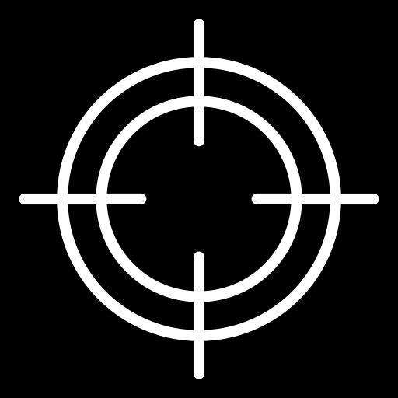
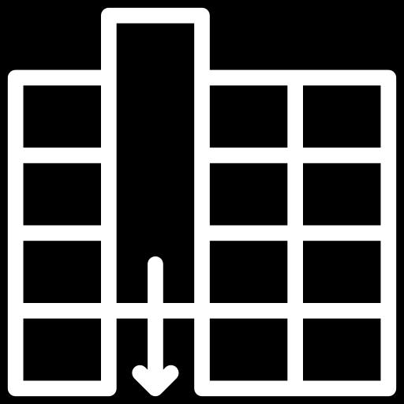
Attack implemented
Clean-label backdoor on 1% and 3% of benign files
Modified 16/32/64/128 features

Slide 23
Experimental hypothesis
Poisoned samples should:
maintain their influence on the learning process even under noise injection or pruning
continue to be classified as benign, behaving as noise-resilient outliers that distort the decision boundary

Slide 24
Automatic tuning algorithm
Functionality preservation
Degradation maximization
Despite being red, Mars is a cold place
It's a gas giant and the biggest planet

Slide 25

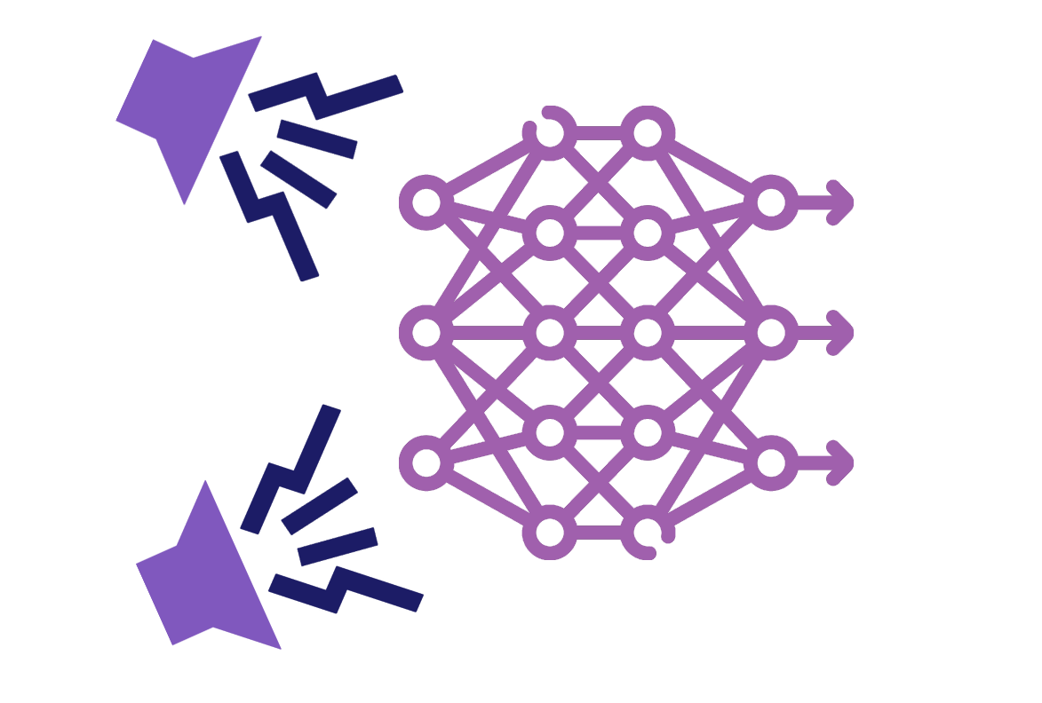
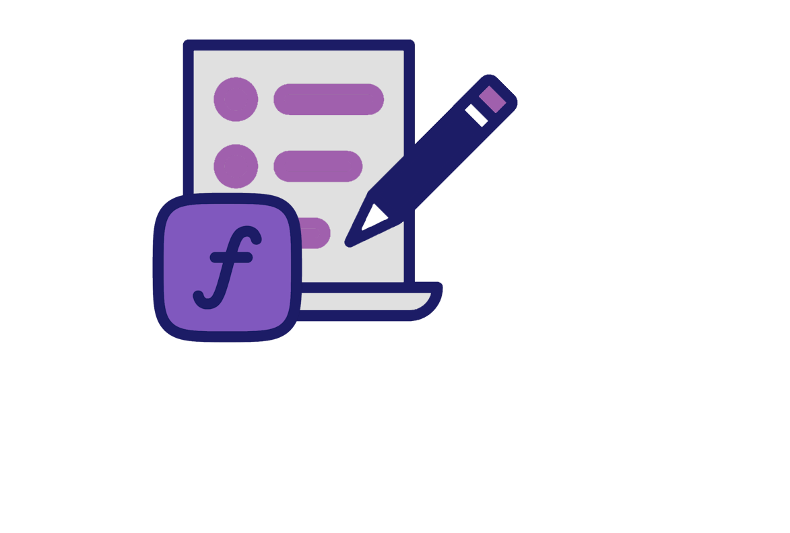
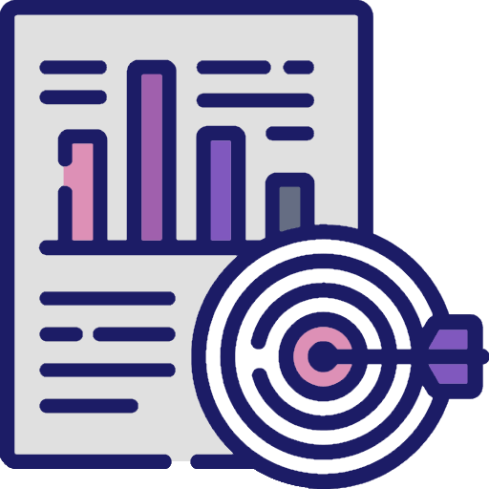
Gaussian noise and selection criteria
01
02
03
04
Noise tested: σ = 0.0001 e σ = 0.01
Noise added only to weights, not to biases
Automatic selection of the “optimal” noise level
accuracy ≥ 50% e massima differenza tra predizione del modello avvelenato e disturbato

Slide 26
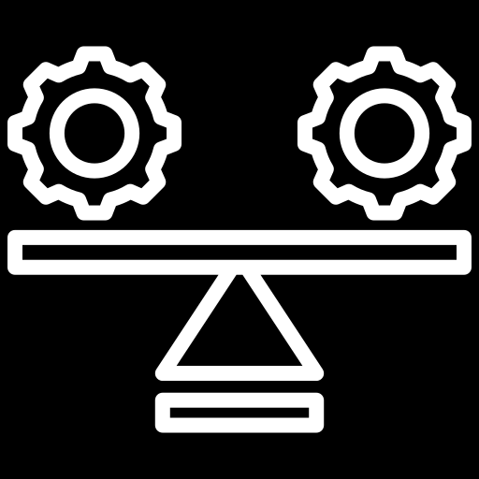
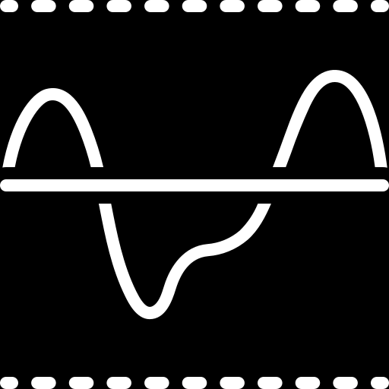
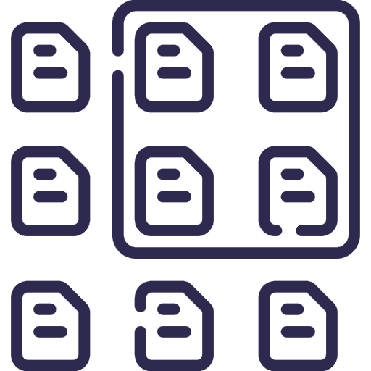
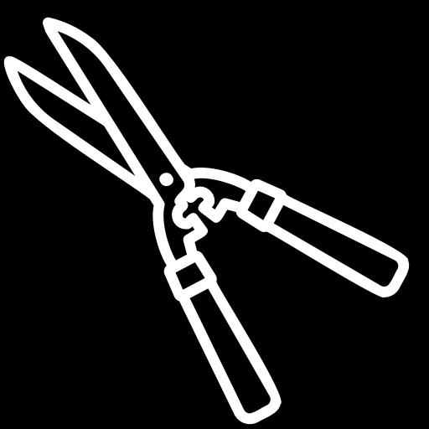
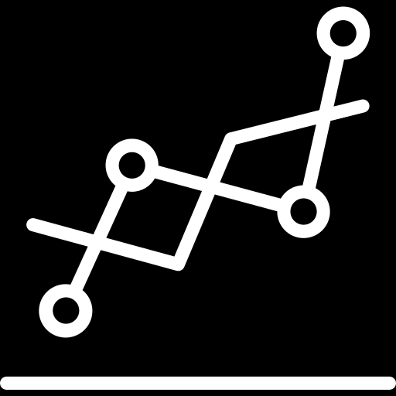
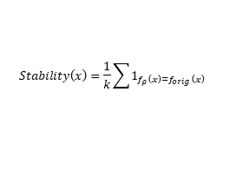
Sparsification
Stability score
Variable Threshold
$$Stability\left(x\right)=\frac{1}{k}\sum{1_{f_{ρ}\left(x\right)=f_{orig}\left(x\right)}}$$
Threshold = 10th percentile of the distribution.
Below this threshold, there is a suspicion of poisoning.
Pruning
Comparison
Pruning on percentages 0–90%. Weights below the ρ quantile are set to zero
The stability of the prediction is analyzed with various pruning rates.

Slide 27
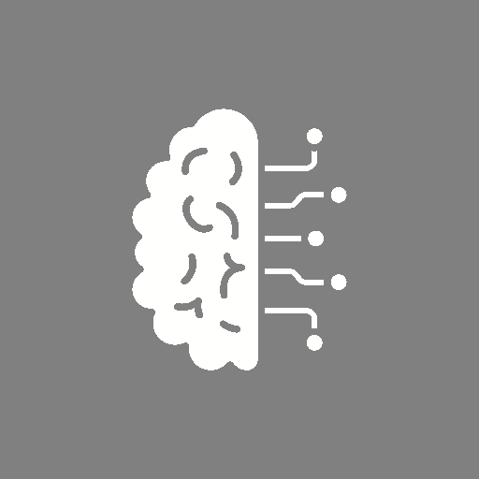


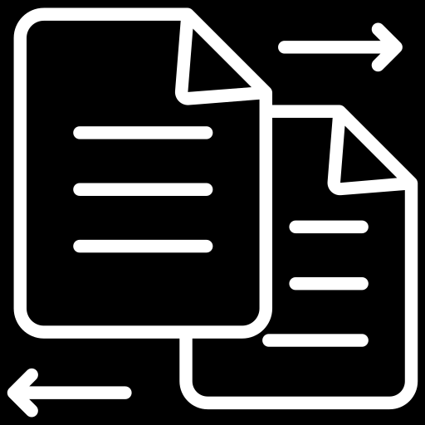
Test pipeline
Model training on poisoned datasets
Stability score calculation and comparison with Isolation Forest
TRAIN
DEFEND
POISON
COMPARE
Clean model training
Noise injection on weights and progressive pruning 0–90%

Slide 28





Test pipeline
POISON
PRUNING
Model training on poisoned datasets
Progressive pruning 0–90%
TRAIN
NOISE
COMPARISON
Clean model training
Noise injection on weights
Stability score calculation and comparison with Isolation Forest

Slide 29
Expected results
Poisoning degrades performance
Poisoned samples are more stable than clean ones
Possible differences in stability
Benchmark comparison: Isolation Forest ~99% recovery
DEGRADATION
STABILITY
PRUNING
BENCHMARK

Slide 30
Data limits
Used only EMBER 2018
Contagio cannot be replicated due to lack of clear subsets
Drebin not accessible
Very large dataset → need for reduction

Slide 31
Testing limitations
Non-optimized iterative pruning
Difficulty in accurately replicating all the metrics in the paper
Calibrated noise but not explored on a large scale
Attacks tested only with 1%–3% poisoning

Slide 32
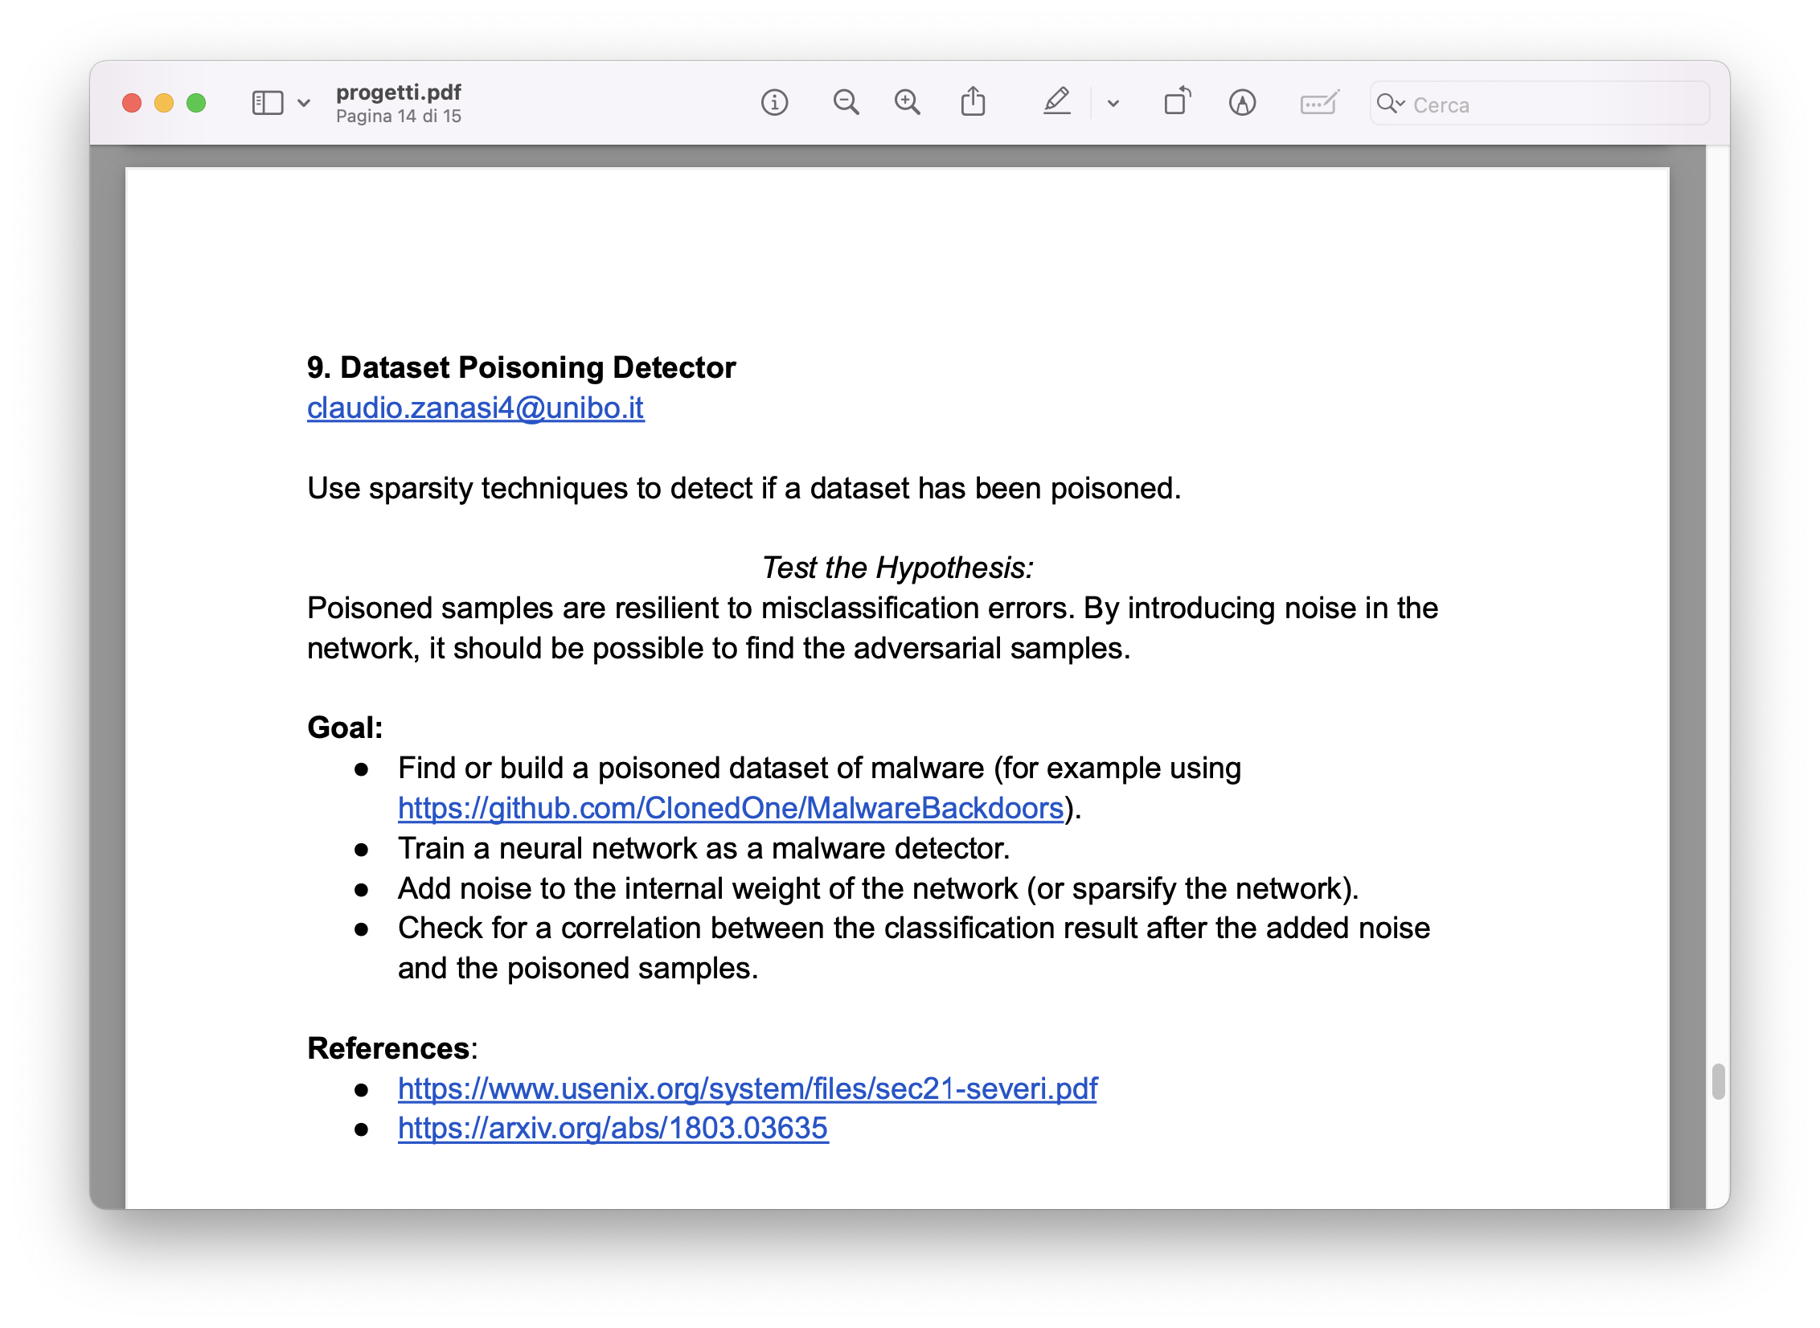
Thesis

Slide 33
THE LOTTERY TICKET HYPOTHESIS: FINDING SPARSE, TRAINABLE NEURAL NETWORKS
Proprierty

Slide 34
Cybersecurity Infographics
MERCURY
VENUS
MARS
It’s a very small planet
Venus has a beautiful name
Mars is a cold place
JUPITER
NEPTUNE
SATURN
Jupiter is the biggest planet
It’s the farthest planet
Yes, Saturn is the ringed one

Slide 35
Cybersecurity Infographics
MERCURY
VENUS
MARS
It’s a very small planet
Venus has a beautiful name
Mars is a cold place
JUPITER
NEPTUNE
SATURN
Jupiter is the biggest planet
It’s the farthest planet
Yes, Saturn is the ringed one

Slide 36
Cybersecurity Infographics
MERCURY
MARS
Mercury is the smallest planet
Mars is actually a cold place
VENUS
NEPTUNE
Venus has a beautiful name
It’s the farthest planet
JUPITER
SATURN
Jupiter is the biggest planet
Yes, Saturn is the ringed one

Slide 37
Cybersecurity Infographics
MERCURY
MARS
Mercury is the smallest planet
Mars is actually a cold place
JUPITER
SATURN
Jupiter is the biggest planet
Yes, Saturn is the ringed one

Slide 38
Cybersecurity Infographics
MERCURY | Mercury is the closest planet to the Sun
NEPTUNE | Neptune is the farthest planet from the Sun
MARS | Despite being red, Mars is actually a cold place
VENUS | Venus has a beautiful name, but it’s very hot

Slide 39
Cybersecurity Infographics
MERCURY
MARS
Mercury is the smallest planet
Mars is actually a cold place
JUPITER
SATURN
Jupiter is the biggest planet
Yes, Saturn is the ringed one

Slide 40
Cybersecurity Infographics
MERCURY
Mercury is the smallest and innermost planet
It’s the farthest
planet from the Sun
NEPTUNE
MARS
Despite being red, Mars is a very cold place
Venus is the second planet from the Sun
VENUS

Slide 41
Cybersecurity Infographics
01
02
03
04
MERCURY
MARS
JUPITER
VENUS
It's the closest planet to the Sun
Despite being red, Mars is a cold place
It's a gas giant and the biggest planet
Venus is the second planet to the Sun

Slide 42
Cybersecurity Infographics
MERCURY
MARS
JUPITER
VENUS
SATURN
It's the closest planet to the Sun
Despite being red, Mars is a cold place
It's a gas giant and the biggest planet
Venus is the second planet to the Sun
Yes, Saturn is the ringed one

Slide 43
Cybersecurity Infographics
MERCURY
VENUS
MARS
It’s a very small planet
Venus has a beautiful name
Mars is a cold place
JUPITER
NEPTUNE
SATURN
Jupiter is the biggest planet
It’s the farthest planet
Yes, Saturn is the ringed one

Slide 44
Cybersecurity Infographics
MERCURY
MARS
Mercury is the smallest planet
Mars is actually a cold place
VENUS
NEPTUNE
Venus has a beautiful name
It’s the farthest planet
JUPITER
SATURN
Jupiter is the biggest planet
Yes, Saturn is the ringed one

Slide 45
Cybersecurity Infographics
MERCURY
MARS
Mercury is the smallest planet
Mars is actually a cold place
VENUS
NEPTUNE
Venus has a beautiful name
It’s the farthest planet
JUPITER
SATURN
Jupiter is the biggest planet
Yes, Saturn is the ringed one

Slide 46
Cybersecurity Infographics
MERCURY
MARS
JUPITER
VENUS
It's the closest planet to the Sun
Despite being red, Mars is a cold place
It's a gas giant and the biggest planet
Venus is the second planet to the Sun

Slide 47
Cybersecurity Infographics
MERCURY
Mercury is the smallest planet
VENUS
NEPTUNE
Venus has a beautiful name
It’s the farthest planet
JUPITER
SATURN
Jupiter is the biggest planet
Yes, Saturn is the ringed one

Slide 48
Cybersecurity Infographics
MERCURY
MARS
JUPITER
VENUS
It's the closest planet to the Sun
Despite being red, Mars is a cold place
It's a gas giant and the biggest planet
Venus is the second planet to the Sun

Slide 49
Cybersecurity Infographics
MERCURY
MARS
Mercury is the smallest planet
Mars is actually a cold place
VENUS
NEPTUNE
Venus has a beautiful name
It’s the farthest planet
JUPITER
SATURN
Jupiter is the biggest planet
Yes, Saturn is the ringed one

Slide 50
Cybersecurity Infographics
MERCURY
MARS
Mercury is the smallest planet
Mars is actually a cold place
VENUS
NEPTUNE
Venus has a beautiful name
It’s the farthest planet
JUPITER
SATURN
Jupiter is the biggest planet
Yes, Saturn is the ringed one

Slide 51
Cybersecurity Infographics
Mercury is the smallest planet of them all
Neptune is the farthest planet from the Sun
JUPITER
VENUS
MERCURY
NEPTUNE
Jupiter is the fifth planet from the Sun and the largest
Venus is the second planet from the Sun. It has a beautiful name

Slide 52
Cybersecurity Infographics
MERCURY
MARS
Mercury is the smallest planet
Mars is actually a cold place
VENUS
NEPTUNE
Venus has a beautiful name
It’s the farthest planet
JUPITER
SATURN
Jupiter is the biggest planet
Yes, Saturn is the ringed one

Slide 53
Cybersecurity Infographics
JUPITER
Jupiter is the fifth planet from the Sun
NEPTUNE
Neptune is the farthest planet from the Sun
SATURN
Mercury is the smallest planet of them all

Slide 54
Cybersecurity Infographics
EARTH
MERCURY
VENUS
MARS
Mercury is the closest planet
Venus has a beautiful name
Mars is a cold place
JUPITER
NEPTUNE
SATURN
Jupiter is the biggest planet
It’s the farthest planet
Yes, Saturn is the ringed one

Slide 55
Cybersecurity Infographics
Mercury is the closest planet to the Sun and the smallest one in the Solar System
1
Jupiter is a gas giant and actually also the biggest planet in the Solar System
2
Saturn is a gas giant in the Solar System, composed mostly of hydrogen and helium
3
Venus has a beautiful name and is the second planet from the Sun

Slide 56
Cybersecurity Infographics
EARTH
NEPTUNE
MARS
MERCURY
Earth is the third planet from the Sun
It’s the farthest planet from the Sun
Despite being red, Mars is a cold place
Mercury is the closest object to the Sun

Slide 57
Cybersecurity Infographics
Venus is the second planet from the Sun
Venus is the second planet from the Sun
Neptune is the farthest known planet

Slide 58
Cybersecurity Infographics
MERCURY
VENUS
Mercury is the closest planet
Venus has a beautiful name
JUPITER
NEPTUNE
Jupiter is the biggest planet
It’s the farthest planet

Slide 59
Cybersecurity Infographics
Despite being red, Mars is a cold place
It’s the farthest planet from the Sun
Jupiter the biggest planet of them all
Mercury closest planet to the Sun
MARS
NEPTUNE
JUPITER
MERCURY

Slide 60
Cybersecurity Infographics
EARTH
NEPTUNE
MARS
MERCURY
Earth is the third planet from the Sun
It’s the farthest planet from the Sun
Despite being red, Mars is a cold place
Mercury is the closest object to the Sun

Slide 61
Cybersecurity Infographics
MERCURY
MARS
Mercury is the smallest planet
Mars is actually a cold place
VENUS
NEPTUNE
Venus has a beautiful name
It’s the farthest planet
EARTH
JUPITER
SATURN
Jupiter is the biggest planet
Is the third planet from the Sun
Yes, Saturn is the ringed one

Slide 62
Instructions for use (free users)
In order to use this template, you must credit Slidesgo by keeping the Thanks slide.
You are allowed to:
Modify this template.
Use it for both personal and commercial purposes.
You are not allowed to:
Sublicense, sell or rent any of Slidesgo Content (or a modified version of Slidesgo Content).
Distribute this Slidesgo Template (or a modified version of this Slidesgo Template) or include it in a database or in any other product or service that offers downloadable images, icons or presentations that may be subject to distribution or resale.
Use any of the elements that are part of this Slidesgo Template in an isolated and separated way from this Template.
Delete the “Thanks” or “Credits” slide.
Register any of the elements that are part of this template as a trademark or logo, or register it as a work in an intellectual property registry or similar.
For more information about editing slides, please read our FAQs or visit Slidesgo School:
https://slidesgo.com/faqs and https://slidesgo.com/slidesgo-school

Slide 63
Instructions for use (premium users)
In order to use this template, you must be a Premium user on Slidesgo.
You are allowed to:
Modify this template.
Use it for both personal and commercial purposes.
Hide or delete the “Thanks” slide and the mention to Slidesgo in the credits.
Share this template in an editable format with people who are not part of your team.
You are not allowed to:
Sublicense, sell or rent this Slidesgo Template (or a modified version of this Slidesgo Template).
Distribute this Slidesgo Template (or a modified version of this Slidesgo Template) or include it in a database or in any other product or service that offers downloadable images, icons or presentations that may be subject to distribution or resale.
Use any of the elements that are part of this Slidesgo Template in an isolated and separated way from this Template.
Register any of the elements that are part of this template as a trademark or logo, or register it as a work in an intellectual property registry or similar.
For more information about editing slides, please read our FAQs or visit Slidesgo School:
https://slidesgo.com/faqs and https://slidesgo.com/slidesgo-school

Slide 64
Infographics
You can add and edit some infographics to your presentation to show your data in a visual way.
Choose your favourite infographic and insert it in your presentation using Ctrl C + Ctrl V or Cmd C + Cmd V in Mac.
Select one of the parts and ungroup it by right-clicking and choosing “Ungroup”.
Change the color by clicking on the paint bucket.
Then resize the element by clicking and dragging one of the square-shaped points of its bounding box (the cursor should look like a double-headed arrow). Remember to hold Shift while dragging to keep the proportions.
Group the elements again by selecting them, right-clicking and choosing “Group”.
Repeat the steps above with the other parts and when you’re done editing, copy the end result and paste it into your presentation.
Remember to choose the “Keep source formatting” option so that it keeps the design. For more info, please visit Slidesgo School.

